Slide 1


MALLA REDDY COLLEGE OF PHARMACY (Affiliated to Osmania university)
A RETROSPECTIVE STUDY ON CLINICAL FEATURES AND MANAGEMENT FOR COVID-19
ACEDEMIC GUIDE:
Dr. SRAVANI .Y
Assistant professor, Pharm D
Mallareddy college of pharmacy
Maisammaguda, secunderabad-100
Telangana state
PROJECTED BY:
PHARM-D V YEAR
SRINITHA -256216882005
NEIL NANDHAN-256216882013
MANISHA-256216882019
KOUSAR BEGUM – 25621883004 (PB)

Slide 2
INTRODUCTION :
COVID-19 is a disease caused by a new strain of coronavirus. 'CO' stands for corona, 'VI' for virus, and 'D' for disease.
The COVID-19 virus is a new virus linked to the same family of viruses as Middle East Respiratory Syndrome (MERS-CoV) and Severe Acute Respiratory Syndrome
(SARS-CoV).

Slide 3
Coronaviruses are zoonotic. This means they first develop in animals before being transmitted to humans.
Once the virus develops in people, coronaviruses can be transmitted from person to person through respiratory droplets. This wet stuff that moves through the air when infected person exhale, cough, sneeze, or talk.
The viral material hangs out in these droplets and can be breathed into the respiratory tract (windpipe and lungs), where the virus can then lead to an infection.

Slide 4
Typically Coronaviruses present with respiratory symptoms. Among those who will become infected, some will show no symptoms. Those who do develop symptoms may have a mild to moderate, but self-limiting disease with symptoms similar to the seasonal flu. Symptoms may include:
Respiratory symptoms
Fever
Cough
Shortness of breath
Breathing difficulties
Fatigue

Slide 5
A minority group of people will present with more severe symptoms and will need to be hospitalized , most often with pneumonia, and in some instances, the illness can include ARDS, sepsis and septic shock. Emergency warning signs where immediate medical attention should be sought include:
Difficulty breathing or shortness of breath
Persistent pain or pressure in the chest

Slide 6
High-Risk Populations
The virus that causes COVID-19 infects people of all ages. However, evidence to date suggests that two groups of people are at a higher risk of getting severe COVID-19 disease:
Older people (people over 70 years of age)
People with serious chronic illnesses such as:
Diabetes
Cardiovascular disease
Chronic respiratory disease
Cancer
Hypertension
Chronic liver disease

Slide 7
AIMS AND OBJECTIVES:
The aim of present study is to describe clinical features and different levels of management in covid 19 infection
OBJECTIVES:
PRIMARY OBJECTIVE: To determine management in covid 19 infection based on symptoms.
SECONDARY OBJECTIVES: Early detection and prevention of complications in covid-19 patients

Slide 8
Need for the study
➢ The need of present study is to describe clinical features and management in covid 19 infection
➢ To quantify the changes or adjustments made to the initial therapy and to determine the appropriateness of antibiotics, antivirals, ppi’s, multivitamins, anticoagulants, steroids and other drugs using standardized quality indicators.
➢ To determine management based on clinical features, early detection and prevention of complications in covid-19 patients

Slide 9
REVIEW OF LITERATURE:
S.NO | TITLE | AUTHOR | PUBLISHED YEAR | CONCLUSION
1. | Clinical features and risk factors for severe inpatients with COVID-19: A retrospective study in China | Juan Wang , Shuzhen Guo , Yili Zhang, Kuo Gao et al | 2020 | The potential risk factors found in our study have shown great significance to prevent COVID-19 patients from aggravating and turning to critical cases during treatment. Meanwhile, focusing on gender and age factors in groups with different severity of COVID-19, and paying more attention to specific clinical symptoms and characteristics, could improve efficacy of personalized intervention to treat COVID-19 effectively.

Slide 10
S.NO | TITLE | AUTHOR | PUBLISHED YEAR | CONCLUSION
2. | A Retrospective Analysis of the Clinical and Epidemiological Characteristics of COVID-19 Patients in Henan Provincial People's Hospital, Zhengzhou, China | Jing Zhao, Hao Gao, Zi-Yi Feng and Qi-Jun Wu | 2020 | Significant differences in demographical and clinical characteristics were observed in patients with moderate and severe COVID-19.

Slide 11
S.NO | TITLE | AUTHOR | CONCLUSION
03 | Symptom Management and Supportive Care of Serious COVID-19 Patients and their Families in India | Naveen Salins, Raj Kumar Mani, Roop Gursahani, Srinagesh Simha, Sushma Bhatnagar (2020) | The COVID-19 pandemic will test human resolve over the next year and perhaps beyond. Not all patients will benefit from or be eligible for ICU care and ventilation. We provide a toolkit for the provision of basic palliative care by intensivists, pulmonologists, and other medical professionals involved in the management of these patients.

Slide 12
METHODOLOGY
AIM | The aim of present study is to describe clinical features and different levels of management in covid-19
OBJECTIVES | PRIMARY OBJECTIVE: To determine management in covid 19 infection based on symptoms. SECONDARY OBJECTIVES: Early detection and prevention of complications in covid-19 patients
Duration of the Study | 6 MONTHS (NOV2020-APRIL2021)
SAMPLE SIZE | 100 PATIENTS

Slide 13
Type of Study | A Retroapective , observational study
Study Site | Malla Reddy Hospital
Inclusion Criteria | All the patients who are diagnosed with COVID 19 Patients who are willing to participate in the study
MATERILAS USED | Data collection form Questionnaires Informed consent form

Slide 14
STUDY PROCEDURE
Methodology:
The study will be conducted in the department of general medicine, Malla reddy Hospital, Hyderabad.
The patients will be selected for the study based on the inclusion and exclusion criteria.
The study procedure will be explained to the subjects and a written consent will be obtained from them.
Confidentiality of the data will be assured to the subjects.
Descriptive data will be applied to the collected data and analysed using software.

Slide 15
DIET
Information regarding patient’s diet was obtained using a food frequency questionnaire.
Multiple items common in the Indian diet and noted as protective (such as those containing Calcium or Vitamin D) or risk factors (such as caffeine) were included in the questionnaire. The subjects were asked whether they were vegetarian. They were also asked if within the past ten years they regularly drank tea, coffee, any other caffeinated drink, alcohol, and milk. If the subject responded in the affirmative to any of the above beverages, they were asked to quantify their intake as average number of glasses per day, week, or month. They were also questioned about smoking. Similarly, all the subjects were questioned about their intake (and quantity per day, week, or month) of curd (plain yogurt), paneer (cottage cheese), fish, and almonds- the former two for their calcium content, and the latter two for an estimate of dietary Vitamin D.
DATA COLLECTION
The subjects are classified based on age, gender, symptoms.
Information will be obtained from the patients and medical records will be noted in a suitably designed Patient Profile Form.
All patients will undergo detailed evaluation about Family History, Past History of disease, social history .

Slide 16
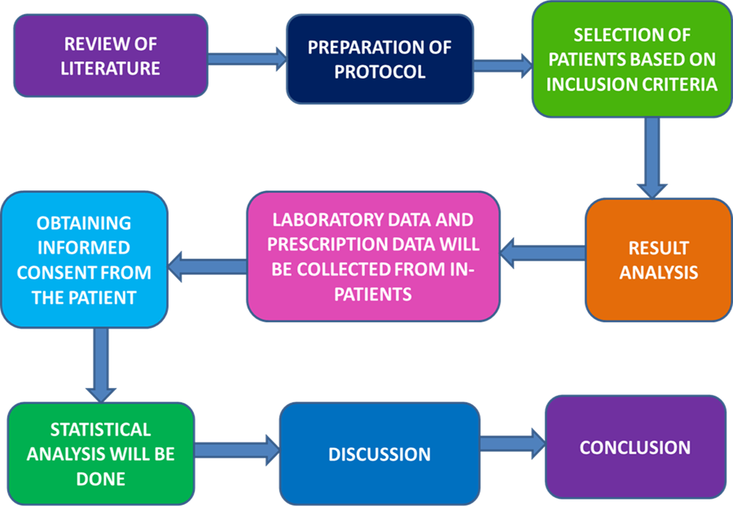
PLAN OF WORK

Slide 17
Reference
Mohamed Abu Haleeqa et al.,Optimizing Supportive Care in COVID-19 Patients: A Multidisciplinary Approach, Journal of Multidisciplinary Healthcare 183.83.167.156 on 03-Mar-2021.
Krithika S. Rao1 et al.,The pathway to comfort: Role of palliative care for serious COVID-19 illness, IJMS, 157,
2020.
Naveen Salins, Symptom Management and Supportive Care of Serious COVID-19 Patients and their Families in India, Indian Journal of Critical Care Medicine (2020):jp-journals-10071-23400

Slide 18
Reference
Websites:
1.https://www.webmd.com/lung/coronavirus
2.https://www.healthline.com/health/coronavirus-covid-19#outlook
3.https://www.who.int/emergencies/diseases/novel-coronavirus-2019/advice-for-public
4.https://www.pathologyoutlines.com/topic/lungnontumorcovid.html

